Slide 1
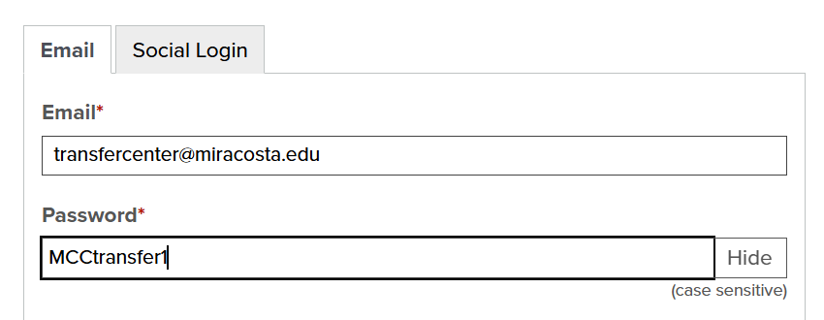
Transferology - SDSU
SDSU 24-25 Catalog
https://transferology.com/login.htm

